Slide 1
Micro Service and Continuous Delivery
郭峰 @ DaoCloud

Slide 2

Let’s Imagine that you are build an online store
Order
Customer
Item
Payment
Dashboard
Cart
Report
Recommend
Monitoring
Comments
Supply

Slide 3

Intimidate Developers

Slide 4
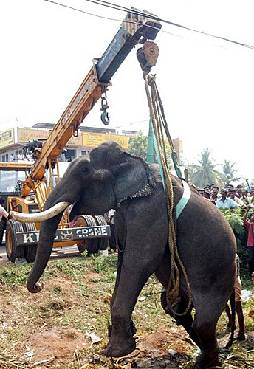
Obstacle to Frequent Development
Need to redeploy everything for a new feature
Interrupts long running background jobs
Increasing risk of failure
Updates will happen less often – really long QA cycles

Slide 5

Overloads Your IDE and Container
Slow down the loop

Slide 6

Require long-term commitment to a tech stack

Slide 7
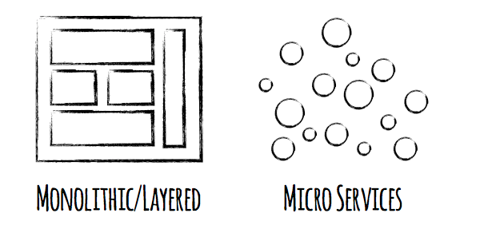


Slide 8
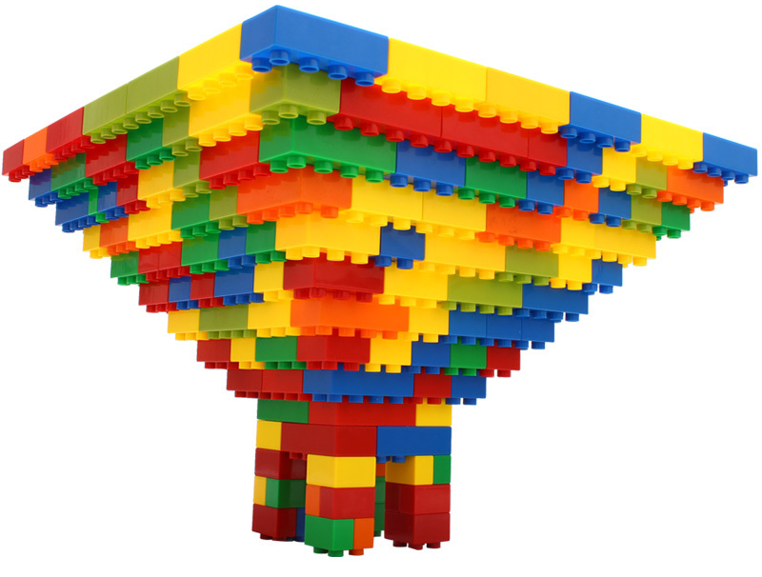
Smaller, simpler apps
Easy to understand and develop
Less dependences
Faster to build and deploy
Even, Failure faster

Slide 9









Best Technology for Each Service

Slide 10

Develop
Deploy
Scale

Slide 11

There are Drawbacks
Complexities on
Develop
Test
A Distributed System
Deploy

Slide 12
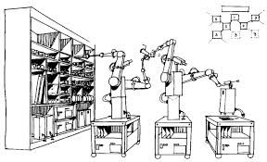
Automation is Implicit

Slide 13
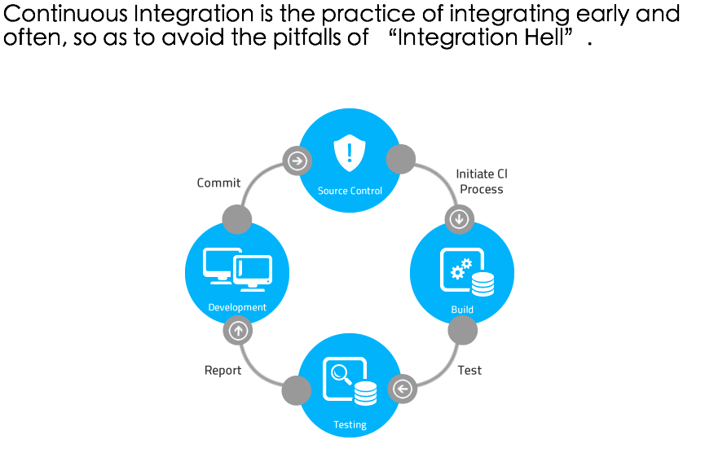
Continuous Integration

Slide 14
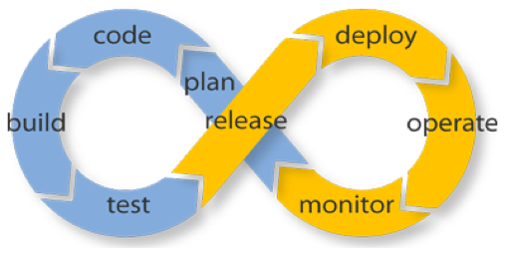
Continuous Integration to Continuous Delivery

Slide 15
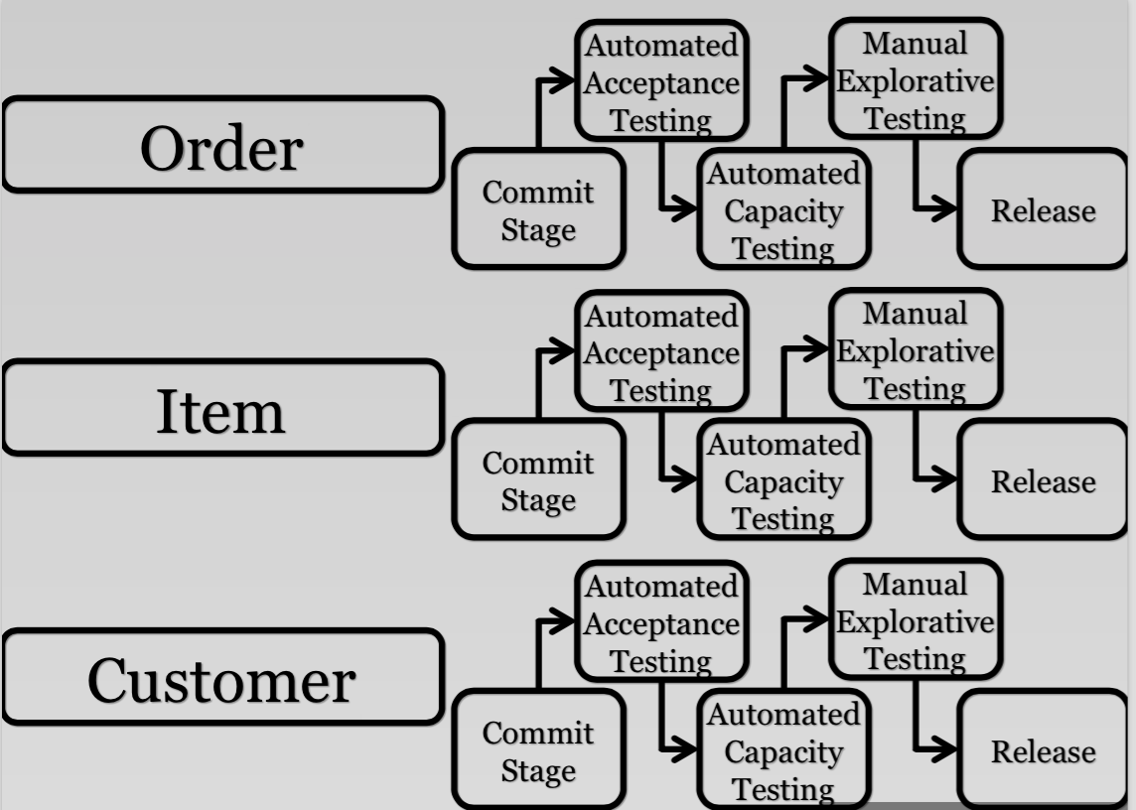
Continuous Delivery ? Continuous Diverse!

Slide 16
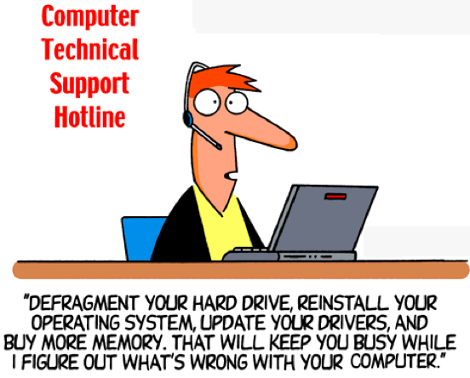
That’s All?
I’m handing tickets for running apps!
Node.js
Python
Ruby
Golang
Java
PHP
…

Slide 17

Duang, Duang…
“Works for me”
“Can’t you reproduce”
“Upgrade to 1.2.5-xx”
“I would appreciate if you could test b/w 3 and 4 am”
“So to trigger the bug you have to install X and Y then configure A, B and C, then download the extra file, put it in this directory.

Slide 18
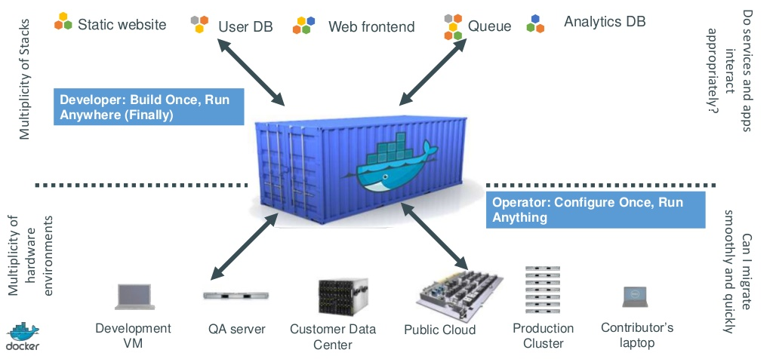
How Docker Helps

Slide 19
Docker & Micro Service
Develop simplest possible solution
Configuration is a runtime constraint
Not extra-extra-complex application
^{new WebServer().start(8080);}
Dev
Manage hardware / infrastructure
^{Monitoring / backups}
Not apps implementation details
Ops

Slide 20
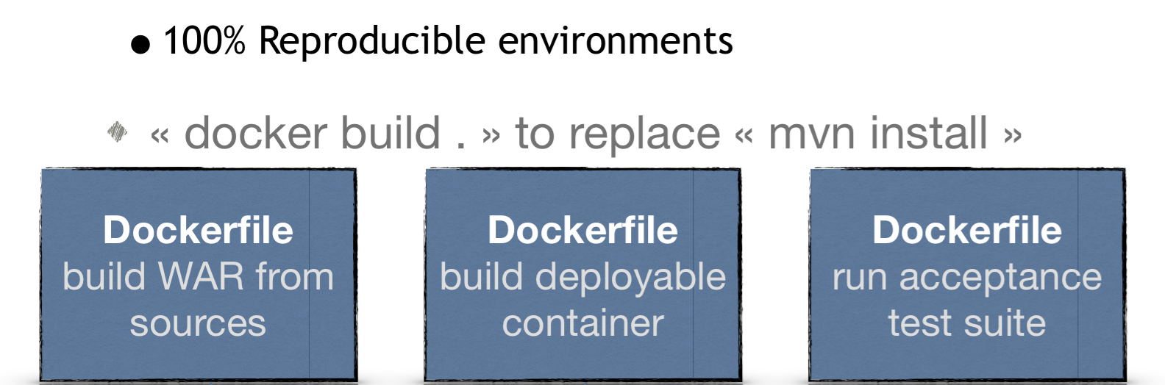
Unified Integration

Slide 21
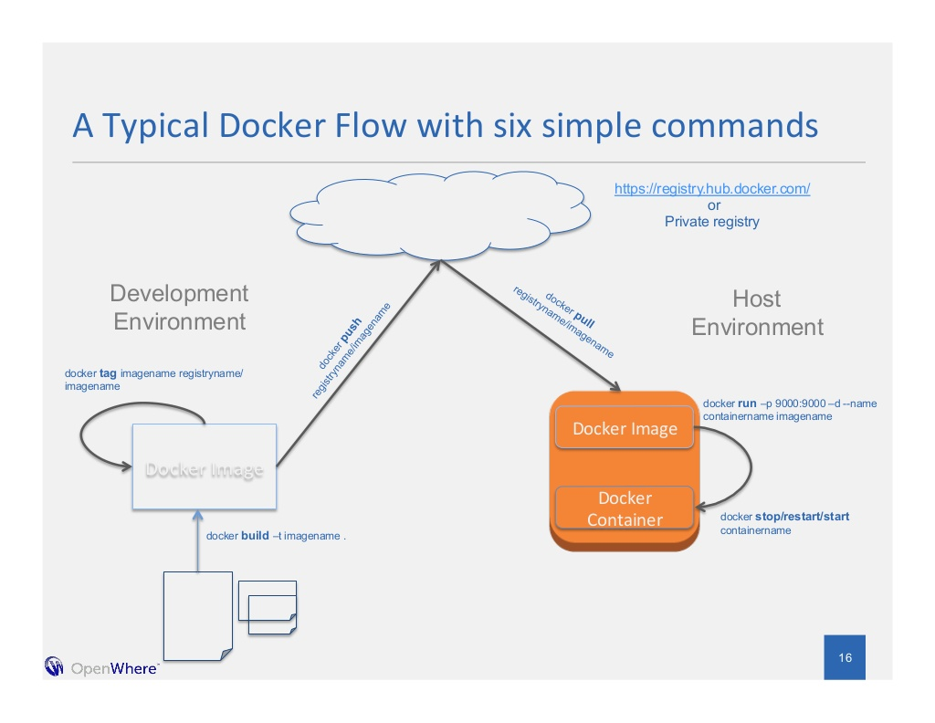
Reproducible Delivery

Slide 22

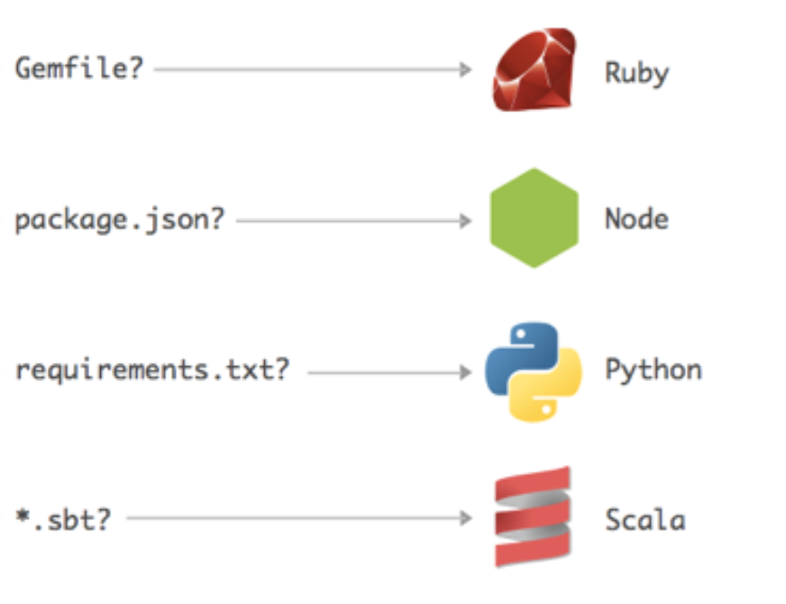
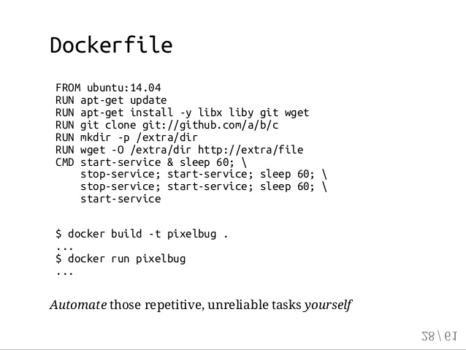
Dockerized Apps

Slide 23
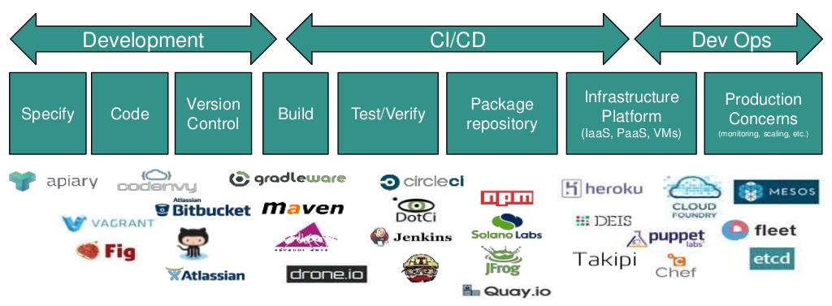

The Landscape with Containers

Slide 24
Q&A

